Slide 1
COMP 307 Project Procrasti-NOT: A Task Manager for Procrastinators
By: Mony Flicky, Priscilia Momo, and Ginika Ume-Onyido

Slide 2
Purpose
The purpose of our website is to serve as a priority manager for those who often procrastinate their work and have them accountable for their tasks.

Slide 3
Motivation
Many people, especially students, push back things they need to do and can appreciate a site to help organize and remind them of upcoming due dates.

Slide 4
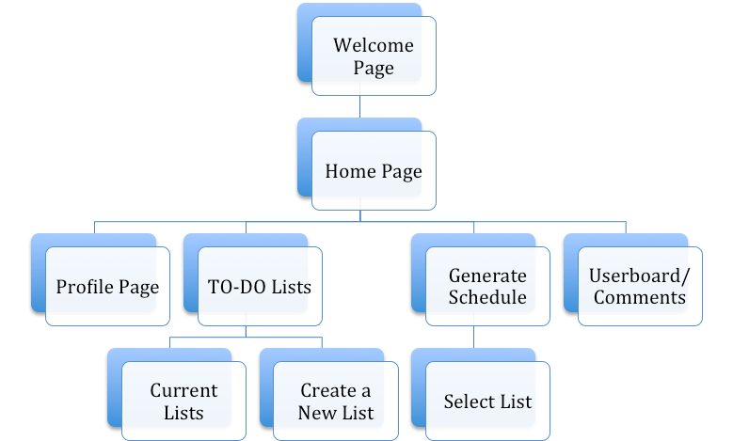
Architecture/Structure

Slide 5
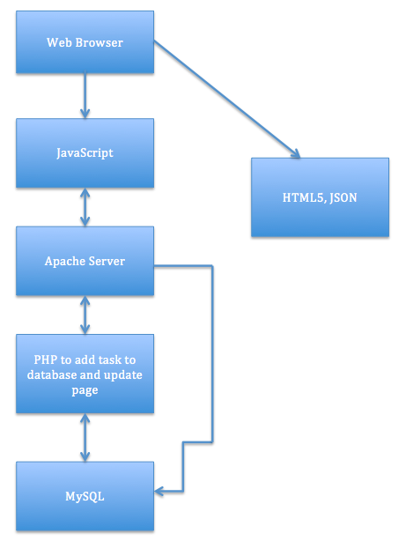
Architecture

Slide 6
Demo
Folder named procrastiNOT in ZIP
Open phpmyadmin and create database named ‘procrastination’
Import ‘procrastination.sql’ database from our procrastiNOT folder
Move folder to htdocs folder in XAMPP and enter http://localhost/ProcrastiNOT/Procrastination/welcome-page.html in the search bar

Slide 7
Our Main Website Features
User is allowed to create a task and add it to a list
Allow user to cross off a task from their list
Remind users of upcoming tasks with the closest due date
Weekly schedule generator
An interactive user-board page for users to publicly interact with each other

Slide 8
Creating/Deleting a Task and Lists (Priscilia)
User is able to create List and Task and delete Tasks
User fill out form to create List and Task
The forms are validated on the web side before being sent to the server.
If you have no list, you will not be able to create a task
In the List page, tasks are regrouped by list and you can delete individual tasks in a list.
Click on the + button to add list

Slide 9
Generating a Weekly Schedule (Ginika)
User is able to generate a sample weekly schedule of their chosen to-do list
Schedule is based on the task priority and colour coded
High priority tasks appear 3 times in red
Med priority tasks appear 2 times in blue
Low priority tasks appear once in
Home page includes reminder of tasks with closest upcoming due date
User gets random motivational message on each loading of their personalized home page

Slide 10
Welcome/Home Page and User Protection (Ginika)
Attractive welcome page that is public to all
Customized home page that displays
The username
The user’s top 5 upcoming tasks with the closest due date
Protect user information after log out procedure through disabling back-tab on end of session
After logging out, essentially clear the history by passing ‘null’ as a parameter in pushState

Slide 11
Registration and Interactive Userboard
This is where users are welcomed to interact with each other.
Users can post a comment on their account and globally see other user’s accounts. They can edit their comments,delete and also reply to other user’s comments.
Users can encourage each other and motivate each other through their interaction on the comment board.
They can also learn more from other users on how to improve their

